Slide 1
Regression Analysis based on sample size and complexity
BY: Priyesh Tewari

Slide 2
Objective of Study: to analyse the behaviour of regression line with increase in sample size and complexity.
Also observe the trend of RSS and RMSE with increase in sample sizes and complexity.

Slide 3
Description of dataset:
Dataset: Diamond
About: dataset contain the prices and other attributes(9 more other than price) of almost 54,000 diamonds
We used linear regression model to predict the price based on carat as predictor.

Slide 4
Question: Analyse the behaviour of regression plots with increase in sample size

Slide 5
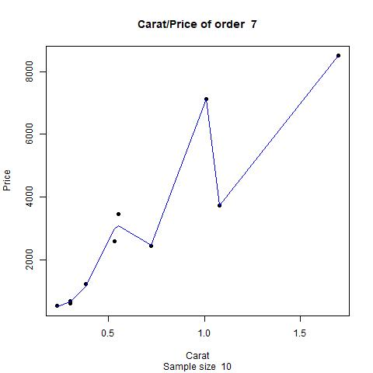
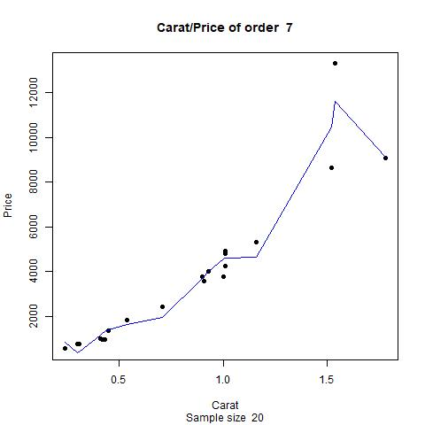
Regression line with increasing sample size

Slide 6
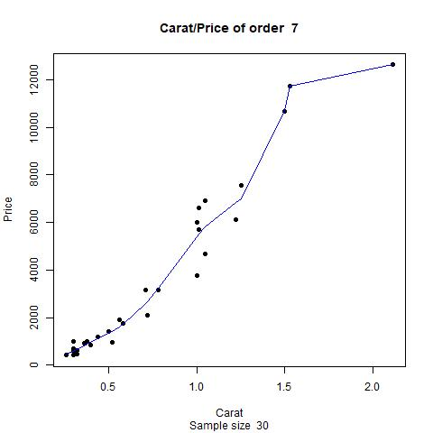
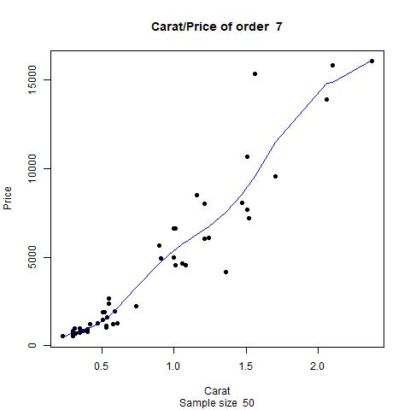
Regression line with increasing sample size

Slide 7
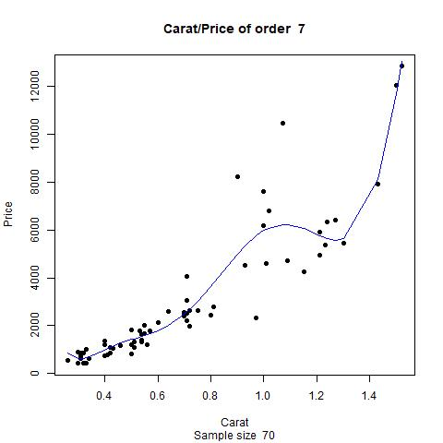
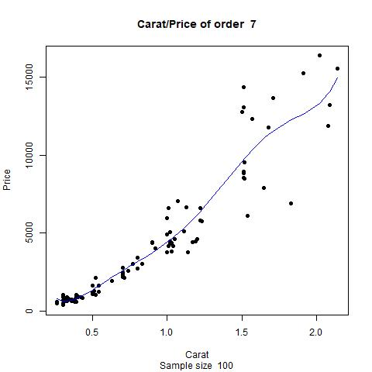
Regression line with increasing sample size

Slide 8
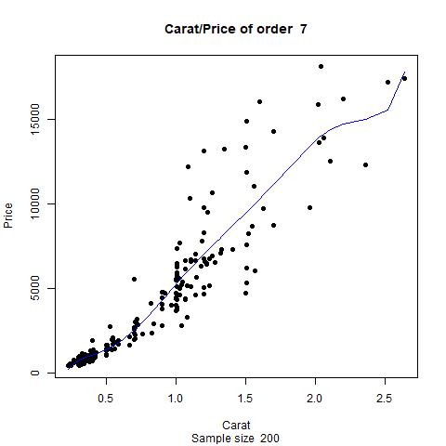
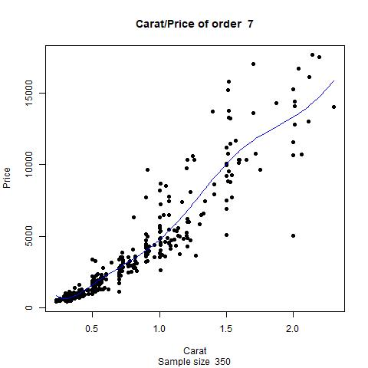
Regression line with increasing sample size

Slide 9
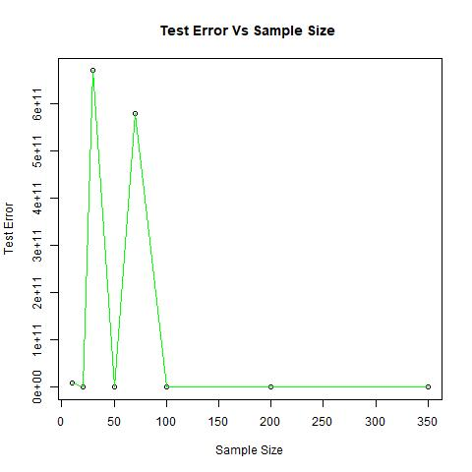
Test RSS with increasing Sample Size

Slide 10
Question: Analyse the behaviour of regression plots with increase in complexity by dividing the sample into 4 equal parts of 20 and 100

Slide 11
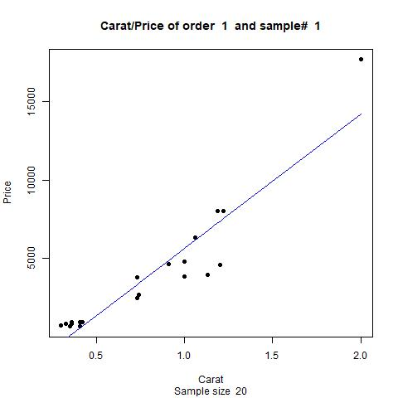
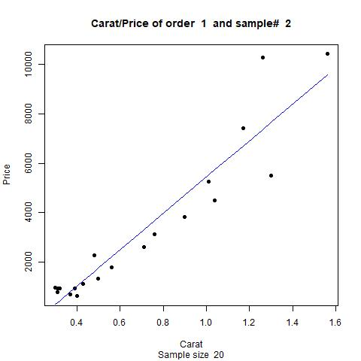
Regression line with increasing complexity

Slide 12
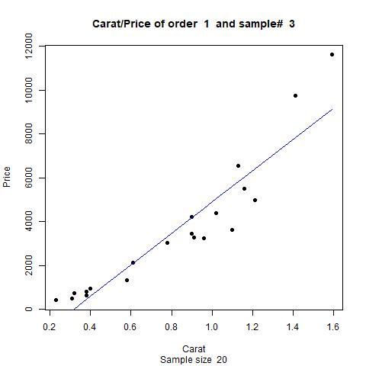
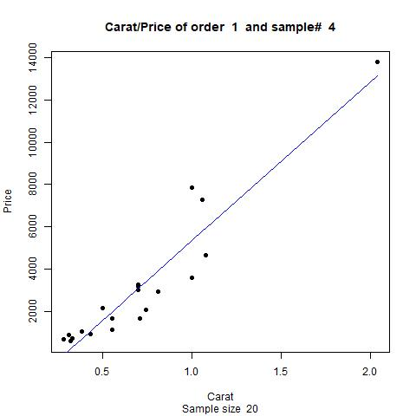
Regression line with increasing complexity

Slide 13
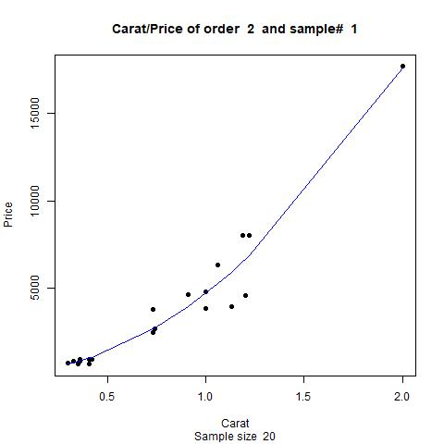
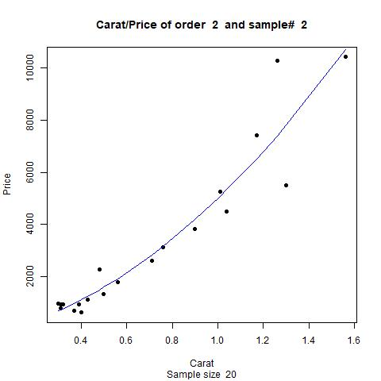
Regression line with increasing complexity

Slide 14
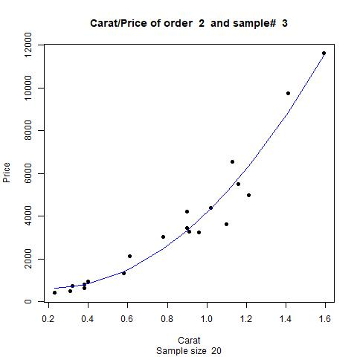
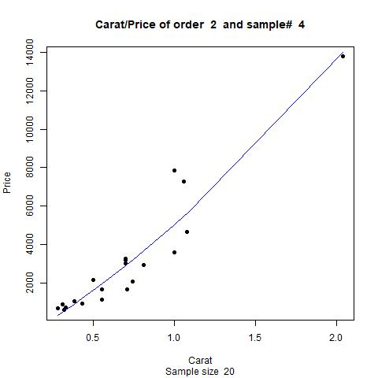
Regression line with increasing complexity

Slide 15
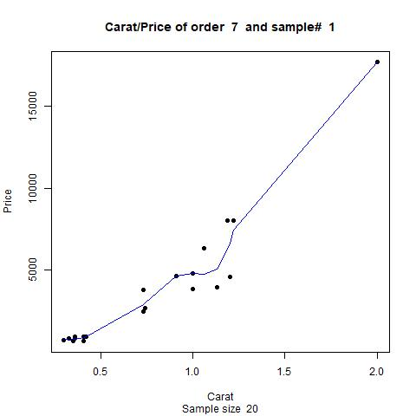
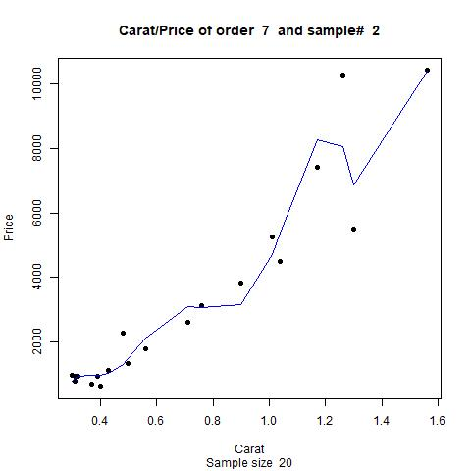
Regression line with increasing complexity

Slide 16
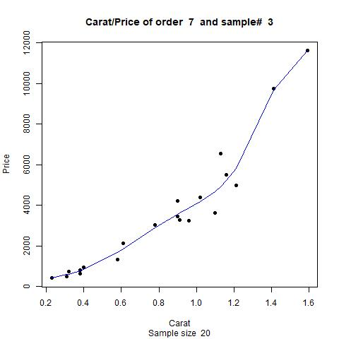
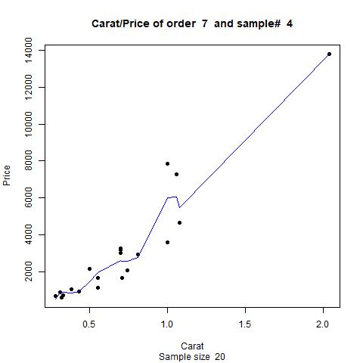
Regression line with increasing complexity

Slide 17
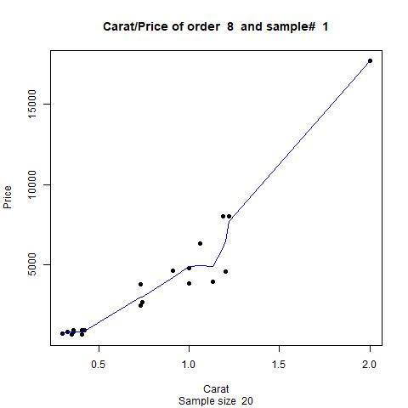
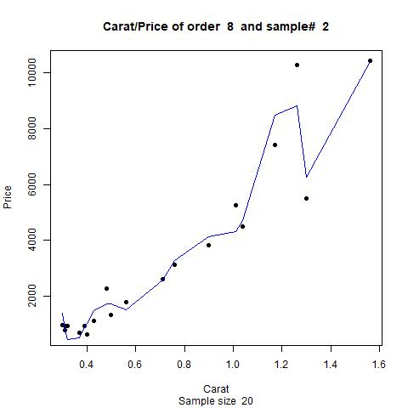
Regression line with increasing complexity

Slide 18
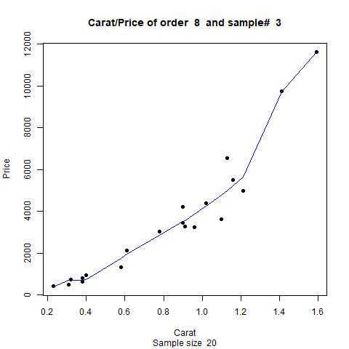
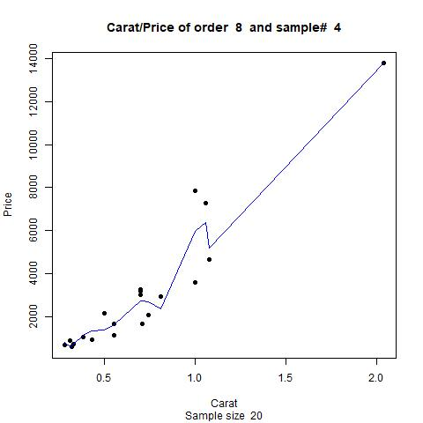
Regression line with increasing complexity

Slide 19
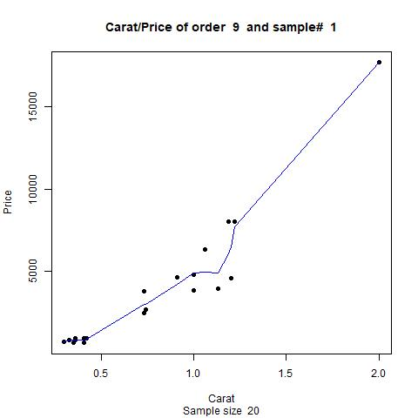
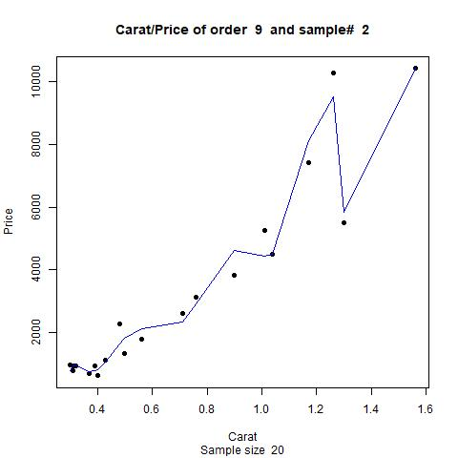
Regression line with increasing complexity

Slide 20
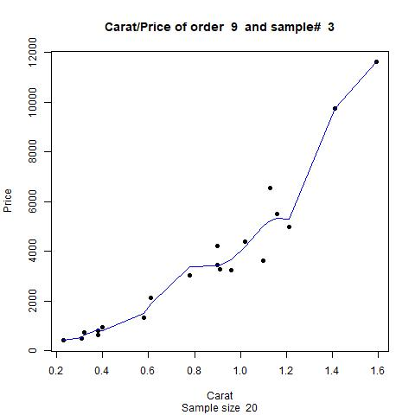
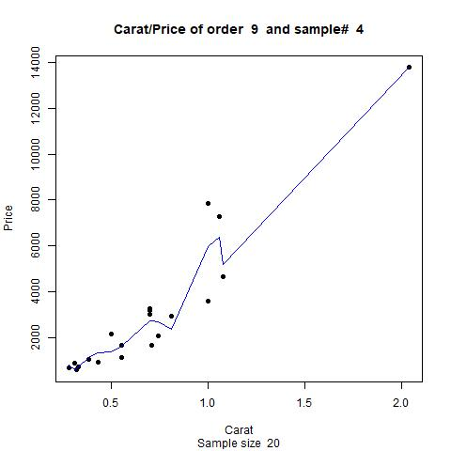
Regression line with increasing complexity

Slide 21
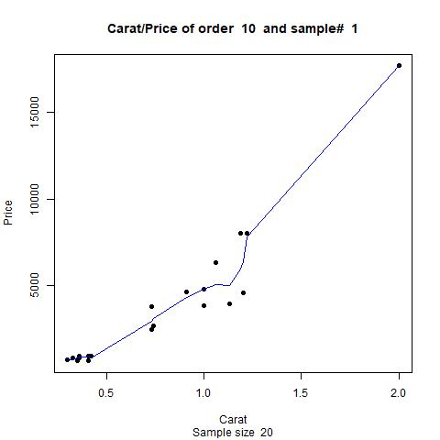
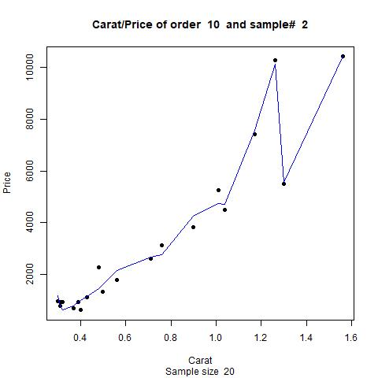
Regression line with increasing complexity

Slide 22
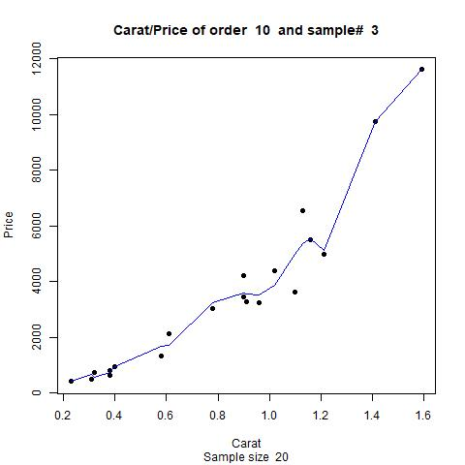
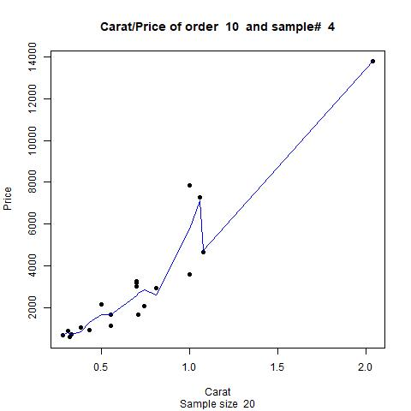
Regression line with increasing complexity

Slide 23
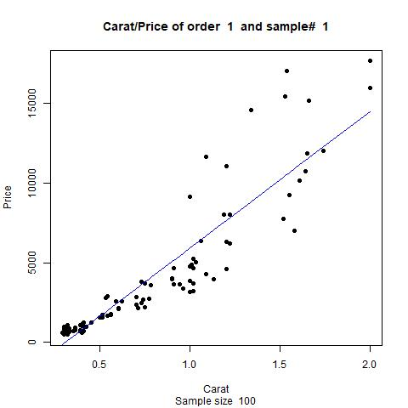
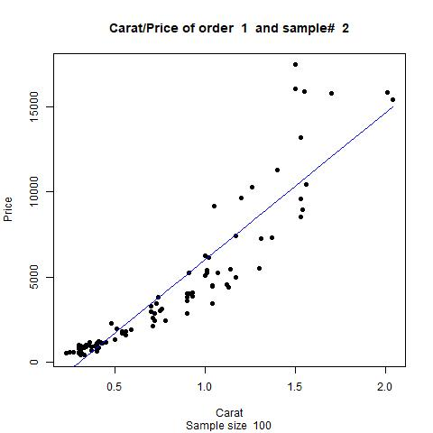
Regression line with increasing complexity

Slide 24
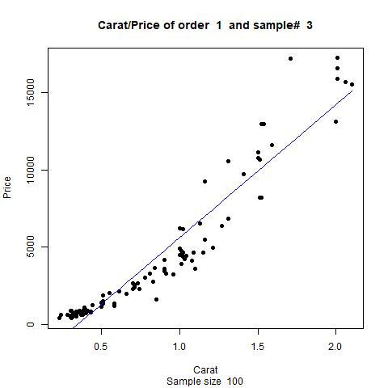
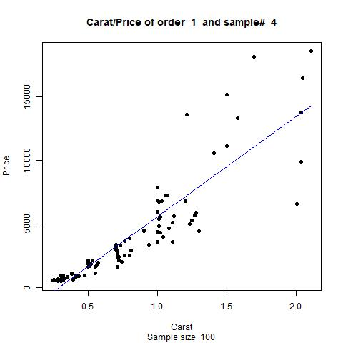
Regression line with increasing complexity

Slide 25
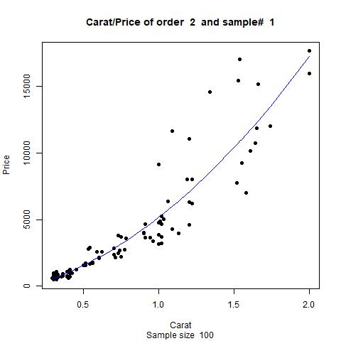
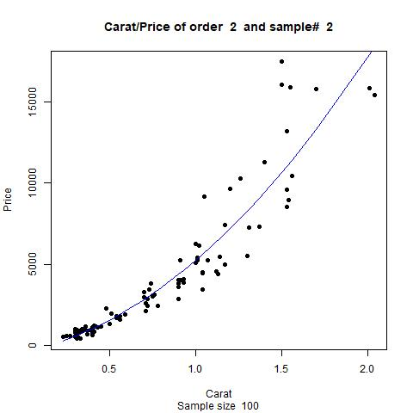
Regression line with increasing complexity

Slide 26
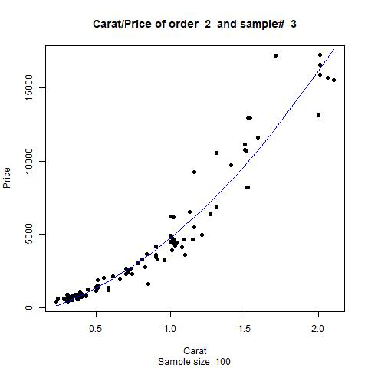
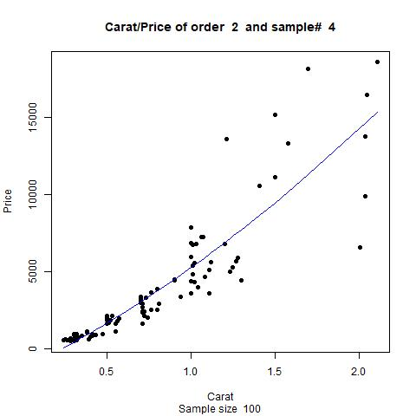
Regression line with increasing complexity

Slide 27
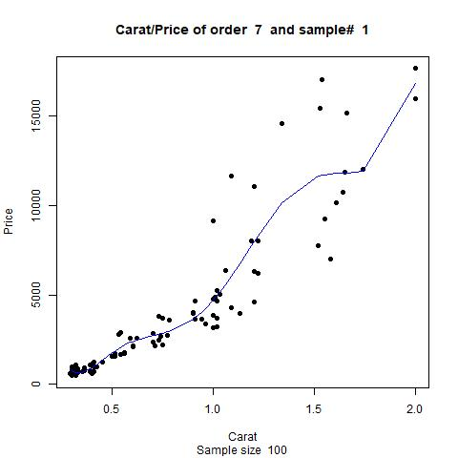
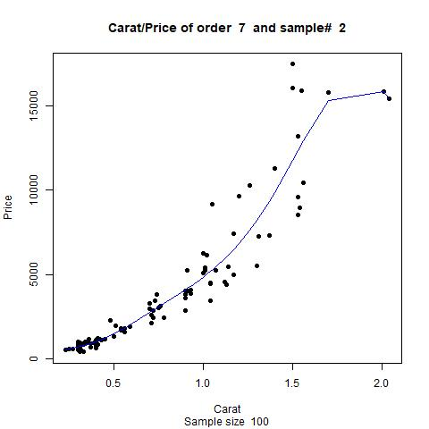
Regression line with increasing complexity

Slide 28
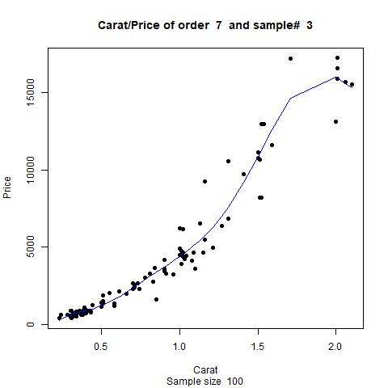
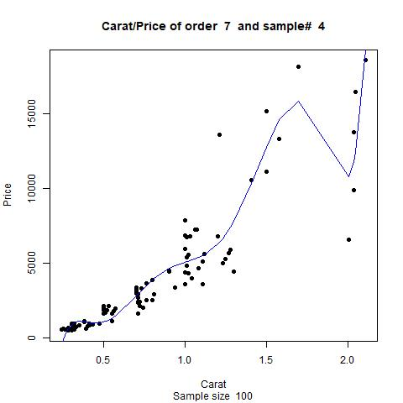
Regression line with increasing complexity

Slide 29
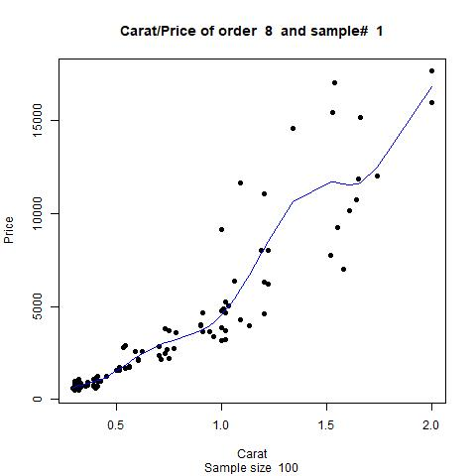
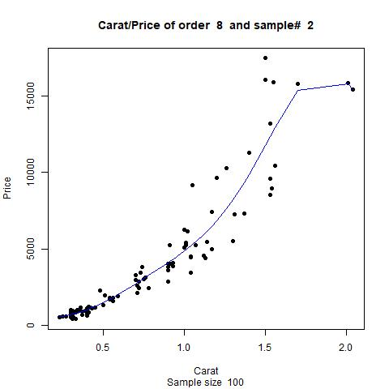
Regression line with increasing complexity

Slide 30
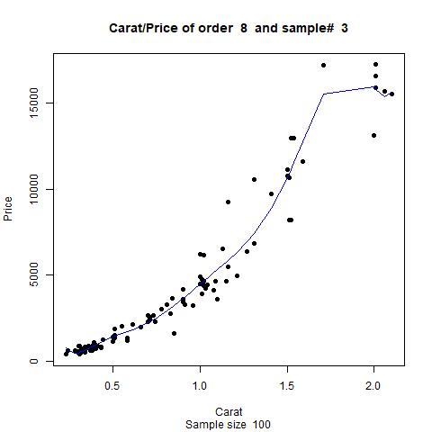
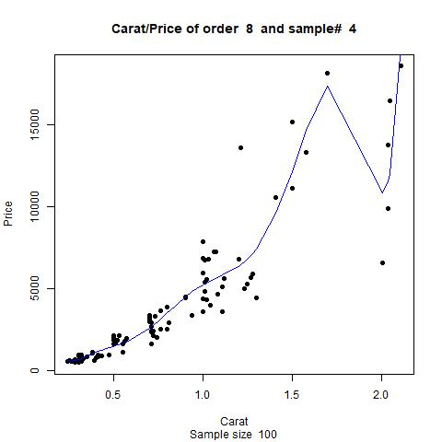
Regression line with increasing complexity

Slide 31
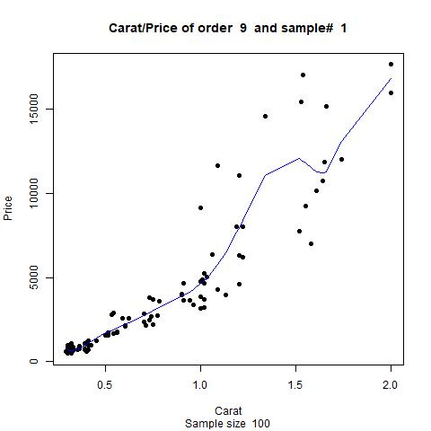

Regression line with increasing complexity

Slide 32


Regression line with increasing complexity

Slide 33


Regression line with increasing complexity

Slide 34


Regression line with increasing complexity

Slide 35


Test RSS v/s Complexity

Slide 36


Test and Train RMSE v/s Complexity (Sample Size = 20)

Slide 37


Test and Train RMSE v/s Complexity (Sample Size = 100)

